Slide 1
Transforming Cabbage into Turnip: Polynomial Algorithm for Sorting Signed Permutations by Reversals
Journal of the ACM, vol. 46, No. 1, Jan 1999, pp. 1-27
Reporter: Chu-Ting Tseng
Advisor：Prof. Chang-Biau Yang
Date：Oct. 11, 2003

Slide 2
Outline
Biological Background
Definitions
Two Chromosome Rearrangements

Slide 3
Biological Background
In the late 1980’s, Palmer and Herbon found that the mitochondrial genomes in cabbage and turnip had very similar gene sequences (many genes are 99% - 99.9% identical) , but with fairly different gene orders.

Slide 4
Biological Background
cabbage
8
7
6
5
4
3
2
1
11
10
9
4
3
2
8
7
1
5
6
11
10
9
turnip

Slide 5

“Direction” of Genes
The direction of the arrows means the ”directions” of genes. So If the direction of arrow is left to rigth the ”direction” of gene is positive and otherwise negative
1
-5

Slide 6
Oriented / Unoriented Blocks
8
7
6
5
4
3
2
1
11
10
9
ORIENTED
BLOCKS
Polynomial
Time
4
3
2
8
7
1
5
6
11
10
9
2
1
3
7
5
4
8
6
UNORIENTED
BLOCKS
NP-Hard
1
2
3
4
5
6
7
8

Slide 7

Definitions of Inversion, Transposition and Inverted Transposition
inversion
transposition
inverted transposition

Slide 8
Reversal Distance
The minimal number of time required to transform permutation A into permutation B.
Ex. A = 1234, B = 1423→d(A,B) = 2
    1234 -> 1324 -> 1423
The reversal distance of A with the identity permutation is noted as d(A)

Slide 9
Sorting by Reversals
Cabbage
8
7
6
5
4
3
2
1
11
10
9
8
7
6
5
4
3
2
1
11
10
9
8
2
3
4
5
6
7
1
11
10
9
8
2
3
4
5
1
7
6
11
10
9
4
3
2
8
5
1
7
6
11
10
9
4
3
2
8
7
1
5
6
11
10
9
4
3
2
8
7
1
5
6
11
10
9
Turnip
4
3
2
8
7
1
5
6
11
10
9

Slide 10





Breakpoint
Consider two genomes and
on the same set of genes , if two genes and are adjacent in A but not in B, they determine a breakpoint in A
Ex:
  = { 3 5 6 7 2 1 4 8 } has 5 breakpoints, (b(π) = 5)
we want to change the permutation to identity permutation
destination: {1 2 3 4 5 6 7 8 }
R
• 3 • 5 6 7 • 2 1 • 4 • 8

Slide 11
Lemma 1
d(A) ≥ b(A) / 2
d(A) : Reversal distance
b(A) : Number of breakpoint
We can eliminate at most two breakpoints in a reversal.
14325 -> 12345

Slide 12
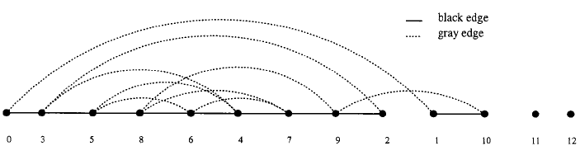
Breakpoint Graph
The unsigned version

Slide 13
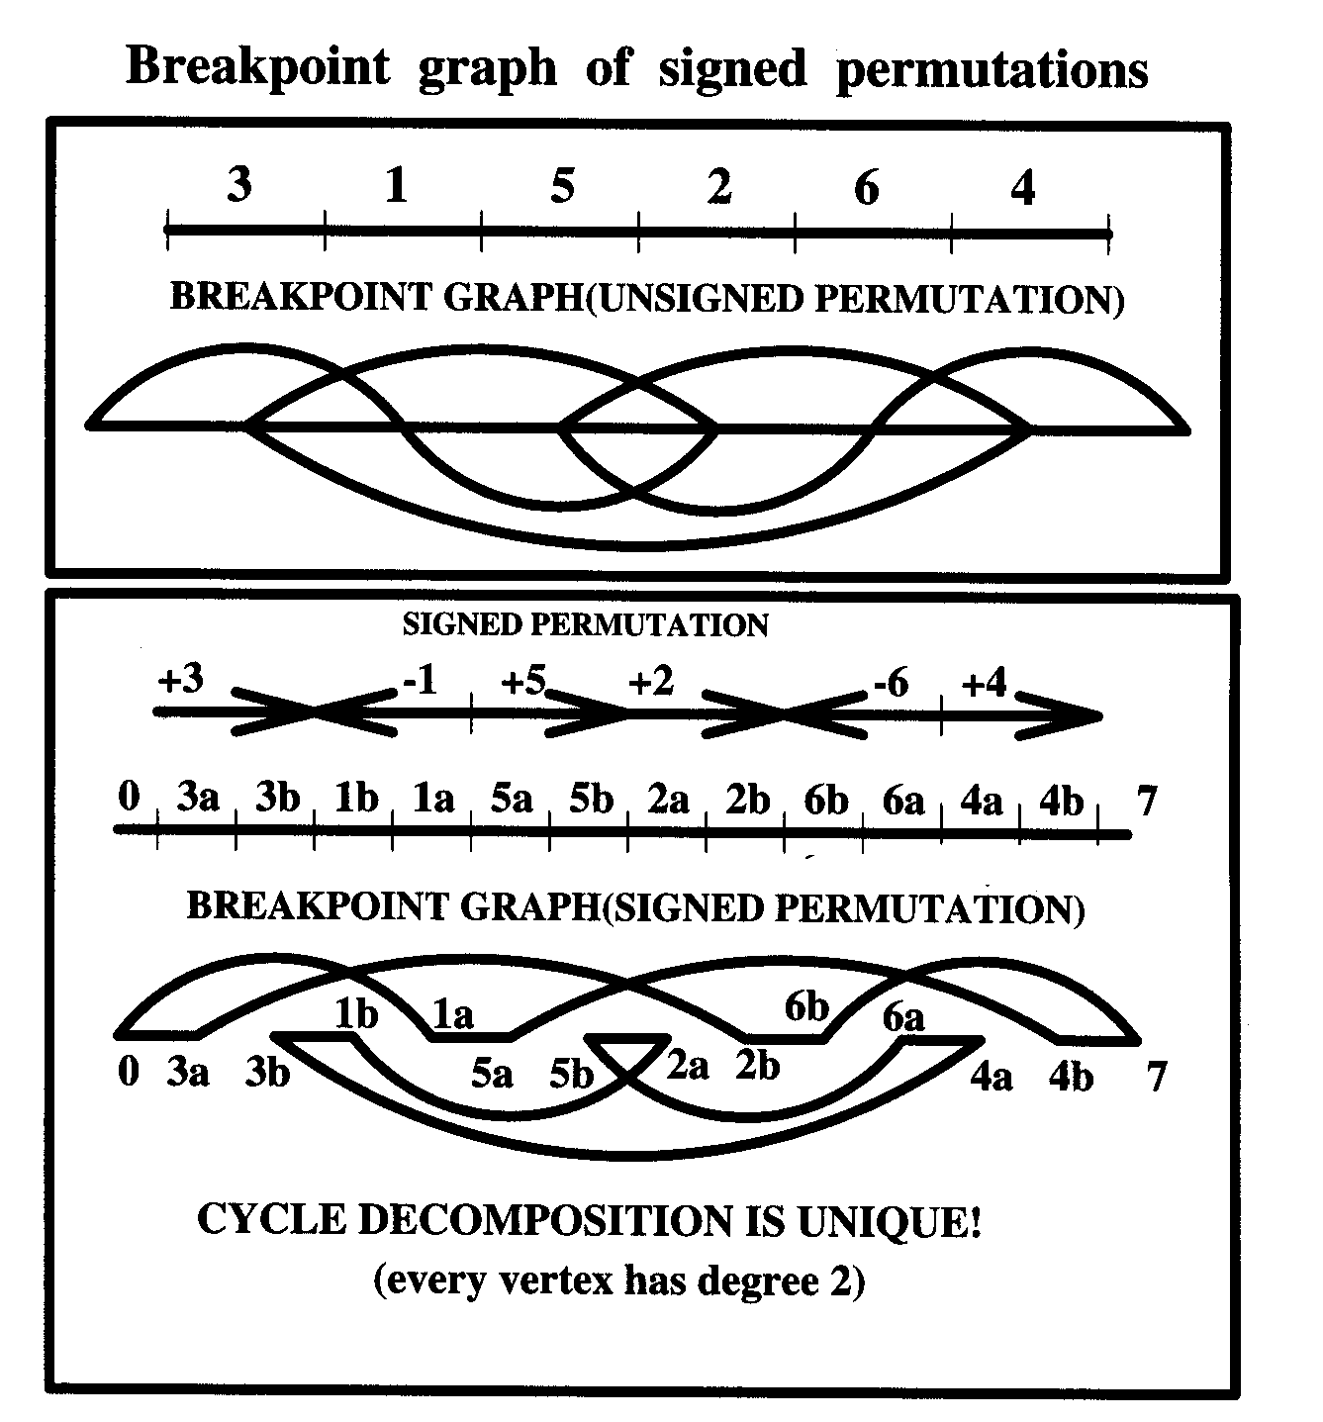
Transforming from signed into unsigned permutation

Slide 14

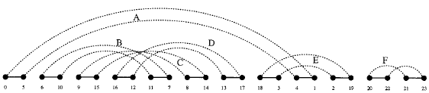
Cycle Decomposition
The number of components is noted as c(A)

Slide 15
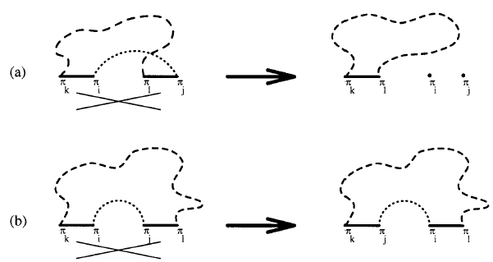
Oriented Edge

Slide 16
Lemma 2
Let (A_{i},A_{j}) be an gray edge incident to black edges (A_{k},A_{i}) and (A_{j},A_{l}). Then (A_{i},A_{j}) is oriented iff i-k= j-l.

Slide 17
Oriented and Unoriented cycle
A cycle is oriented if it has an oriented edge, unoriented otherwise.

Slide 18
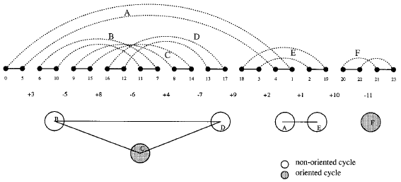
Interleaving graph

Slide 19
Lemma 3
Every reversal changes the parameter b(A) – c(A) by one.
d(A) ≥ b(A) – c(A)

Slide 20

Separation of components

Slide 21
Containment Partial Order
U ≺ W iff Extent(U) ⊂ Extent(W) , U and W are unoriented components.

Slide 22
Hurdles
There are two kinds of hurdles: minimal hurdle, greatest hurdle.
An unoriented component U that is a minimal component in ≺ is a minimal hurdle.

Slide 23
Lemma 4
b(A) – c(A) + h(A)≦d(A)≦ b(A) – c(A) + h(A)+1

Slide 24
Hurdles
An unoriented component U that is a greatest component in ≺ is a greatest hurdle, if U does not separate any two minimal hurdles.
The number of hurdles is noted as h(A)

Slide 25
Super Hurdles
A hurdle K∈u_{π} protects a non-hurdle U ∈u_{π} if deleting K from u_{π} transforms U from non-hurdle into a hurdle.
A hurdle in π is a super hurdle if it protects a non-hurdle U∈u_{π} and a simple hurdle otherwise.

Slide 26
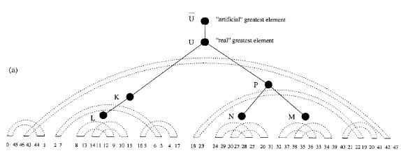
Superhurdle

Slide 27
Fortress
A permutation π is called a fortress if it has odd number of hurdles and all of these hurdles are superhurdles.

Slide 28

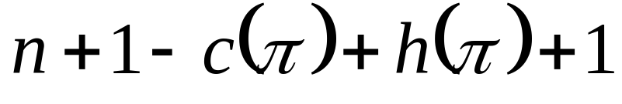
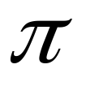
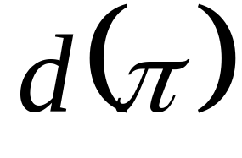
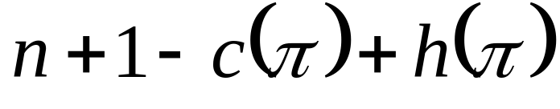
Theorem
is a
fortress
if
=
otherwise

Slide 29
Thanks for your attention

